Slide 1
Exploratory Data Analyis- Retail (SuperStore)
File created on: 13/02/2022 9:34:07 PM

Slide 2
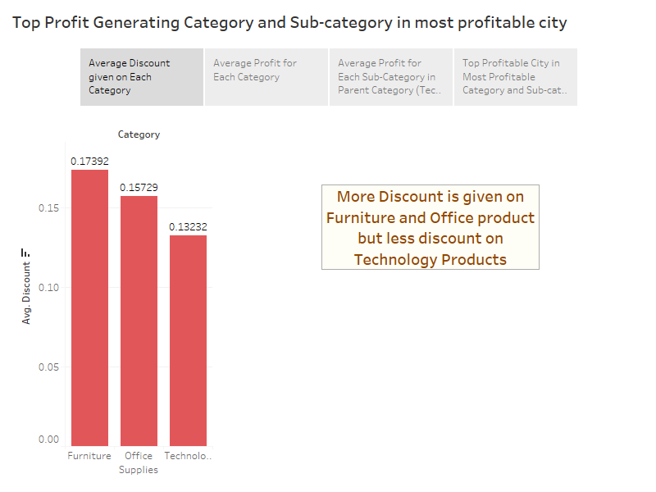

Slide 3
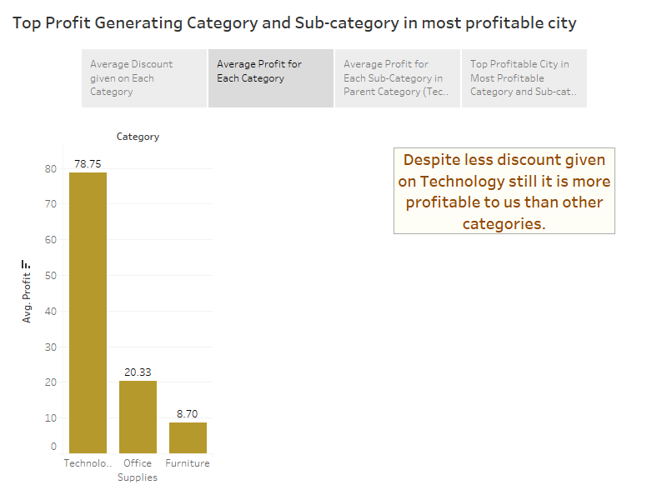

Slide 4
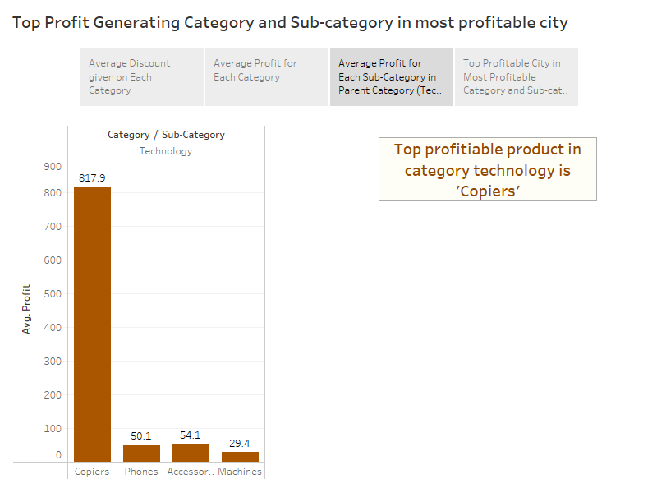

Slide 5
